Slide 1
TITTLE Analysis of used cars data and hashtag data in twitter using spark in HDP and jupyter notebook.
TEAM MEMBERS :
DIVYA KUMARI.
SUNIL GUPTA.
URVASHI UPADHYAY.
T.SAI DINESH.
GUIDED BY :
ALWYN MICAIAH

Slide 2
TECHNOLOGIES USED : →APACHE SPARK →HDFS →SPARK SQL →JUPYTER NOTEBOOK →PYTHON →HIVE
CLIENT NAME : CARS24.
PROBLEM STATEMENT : We are having a data set of used cars . We need some insights from the data set and the insights we needed are given below. And also we some analysis on some hashtags data in twitter . The hashtags and the insights were given below.
INSIGHTS :
The highest price and the lowest price of the cars.
Region having the highest number of cars.
Cars which are manufactured by Mercedes-Benz or Ferrari and black in color.
Cars whose manufacturer name starts with name ‘m’ and price more than 100000.

Slide 3
C
5. We need a new column which has the fields two times of its price.
6. Rename the column ‘odometer’ of our data set to ‘odometer value’.
7. Count of cars from region “auburn” which covered a distance greater than 70000.
8. Region where the models ‘f-150’ or ‘compass’ , ‘Tacoma’ were available in black color.
9. Data of manufacturer ,model , transmission where price is greater than 50000.
10. Model of the car which was purchased mostly.
11. Region which is having the highest number of cars.
12. Region which is having the highest number of cars.
13. In a particular year which color cars are the most sold.
14. Count of cars posted in different years.
15. count of cars according to their conditions for a particular manufacturer.
16. We need our data to be partitioned on the basis of state.
17. We need our data to be bucketed into 50 buckets based on id.
18. Write our data into a parquet file and using that give the count of cars year-wise.
19. Write our data into a json file.
20.We are having some IPL data in hive . Get that data to here and give that to us in a csv file.
21. We need our data to be partitioned on the basis of posting month.

Slide 4
C
HASHTAGS FOR TWITTER DATA ANALYSIS :
#RohitSharma
#Teachersday
#SiddharthShukla
Insights for hashtags data :
Get the count of locations from where the tweets came on #rohithsharma.
Get the name of the user with high number of followers who gave #siddharthshukla.
Get the count of locations from where the tweets came on #teachersday.
To get the trending the topics of India in tweeter.

Slide 5
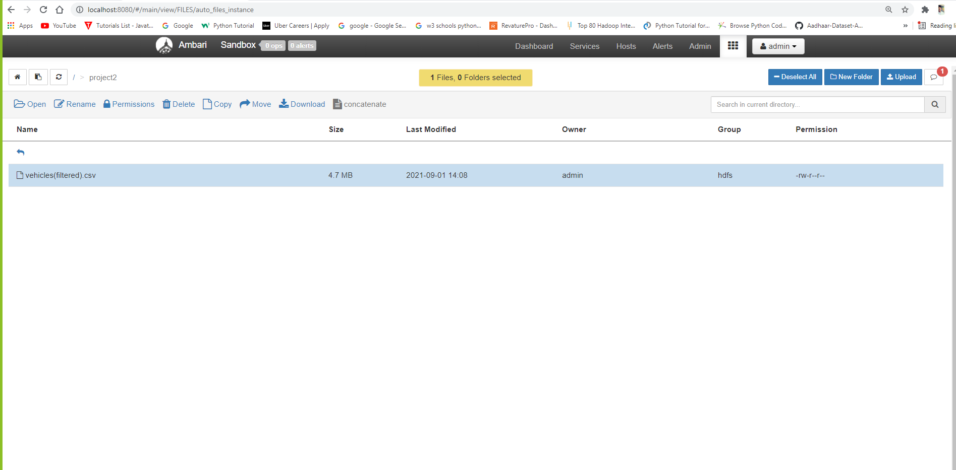
Loading data into Ambari.

Slide 6
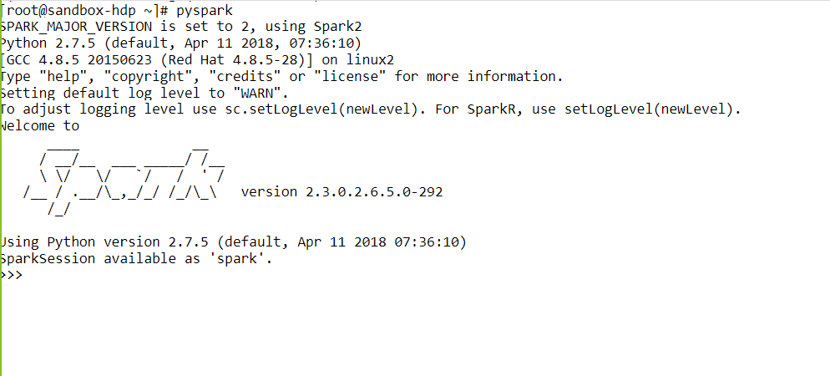
Launching Spark shell in HDP.

Slide 7
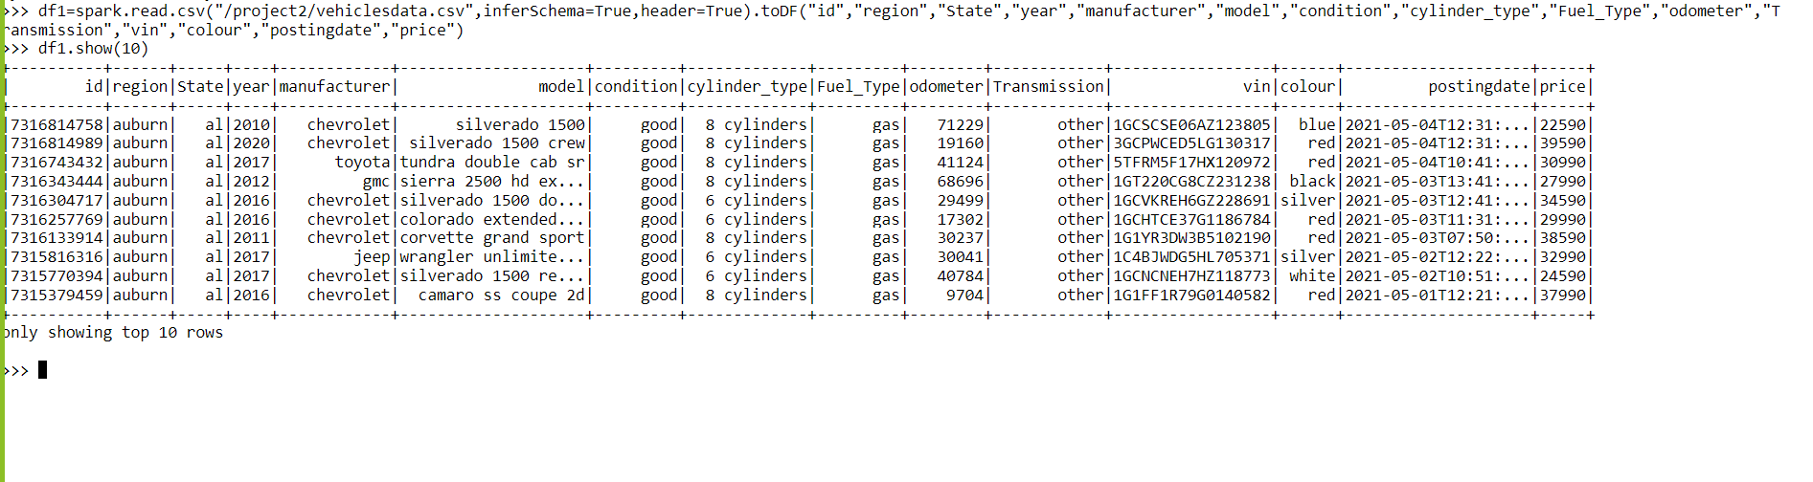
Creating the data frame and loading the dataset into it. Command: df1=spark.read.csv(“/project2/vehiclesdata.csv”,inferSchema=True,header=True).toDF(“id”,”region”,”state”,”year”,”manufacturer,”model”,”condition”,”cylinder_type”,”fuel_type”,”odometer”,”Transmission”,”vin”,”colour”,”postingdate”,”price”)

Slide 8
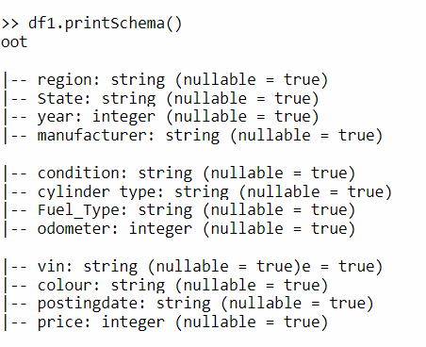
To get the Schema of the data frame. Command: df1.printSchema()

Slide 9
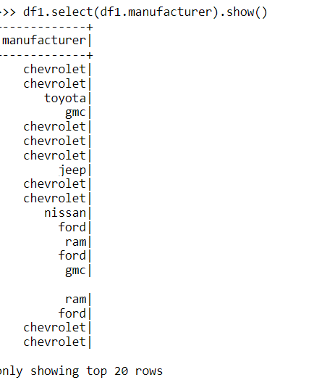
Selecting a particular column in data frame. Command : df1.select(df1.manufacturer).show()

Slide 10
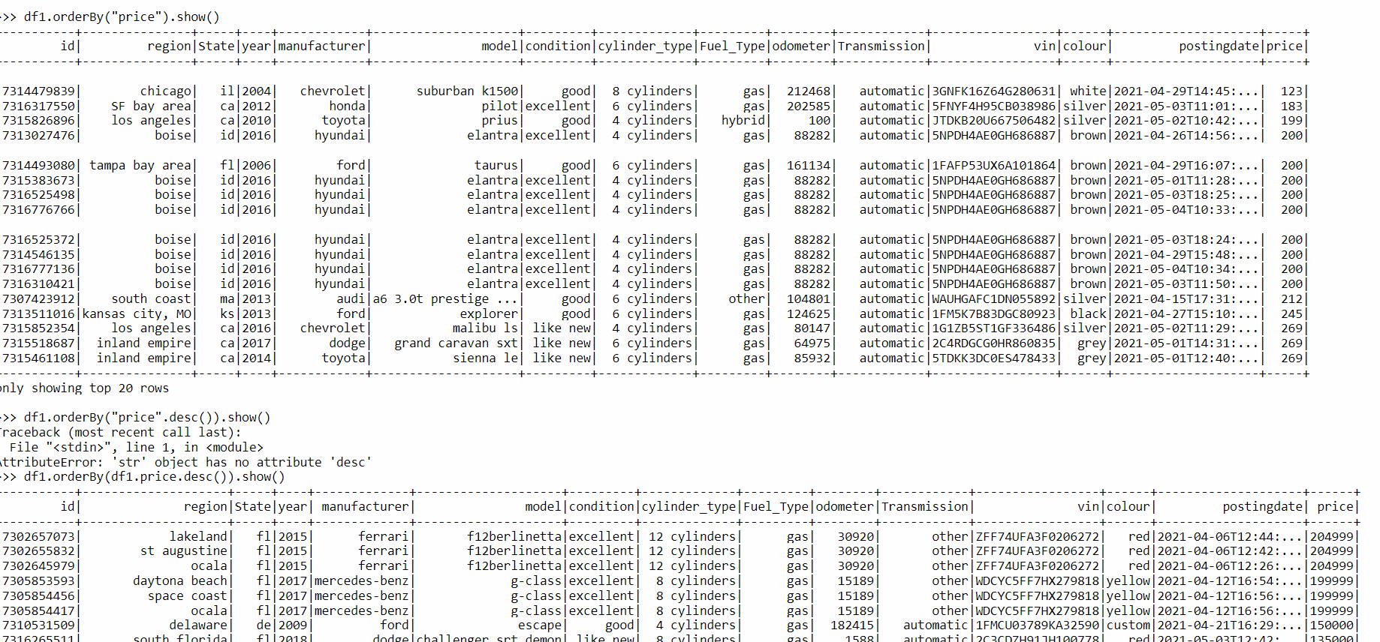
To sort the data into particular order based on a column. Command : df1.orderBy(“price”).show() ---->>ascending order. df1.orderBy(df1.price.desc()).show() -->descending.

Slide 11
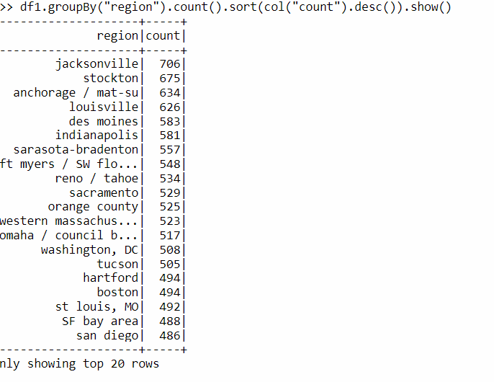
Grouping the data based on a column and sorting the count by descending order. Command : df1.groupBy(“region”).count().sort(col(“count”).desc()).show()

Slide 12
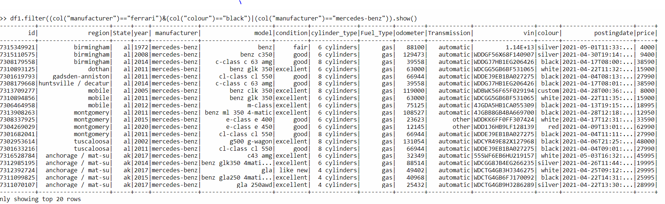
Getting the data where manufacturer=‘Ferrari’ and color=‘black’ or manufacturer= “ Mercedes-Benz”using ‘FILTER’ function. Command : df1.filter((col(“manufacturer”)=“Ferrari”)&(“colur”==“black”)|(col(“manufacturer”)==“mercedesbenz”)).show() df1.filter(((col(“manufacturer”)==“Ferrari”)|(col(“manufacturer”==“mercedes-Benz”))&(col(“colour”)==“black”)).

Slide 13
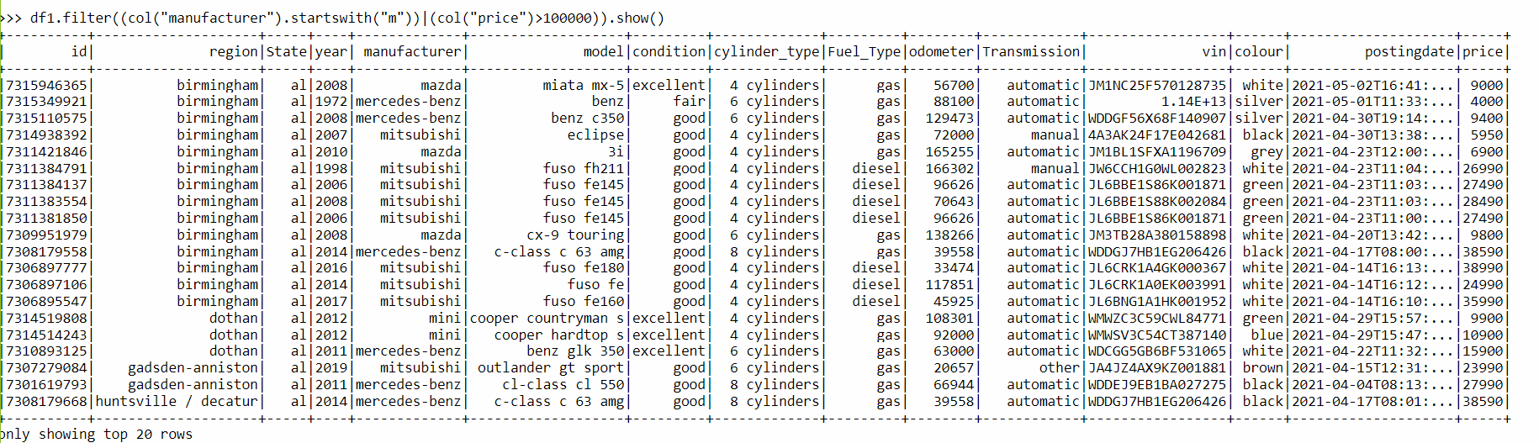
To get the data of manufacturer whose name starts with “m” and their price greater than 100000. Command : df1.filter((col(“manufacturer”).startswith(“m”))|(col(“price”)>100000)).show()

Slide 14
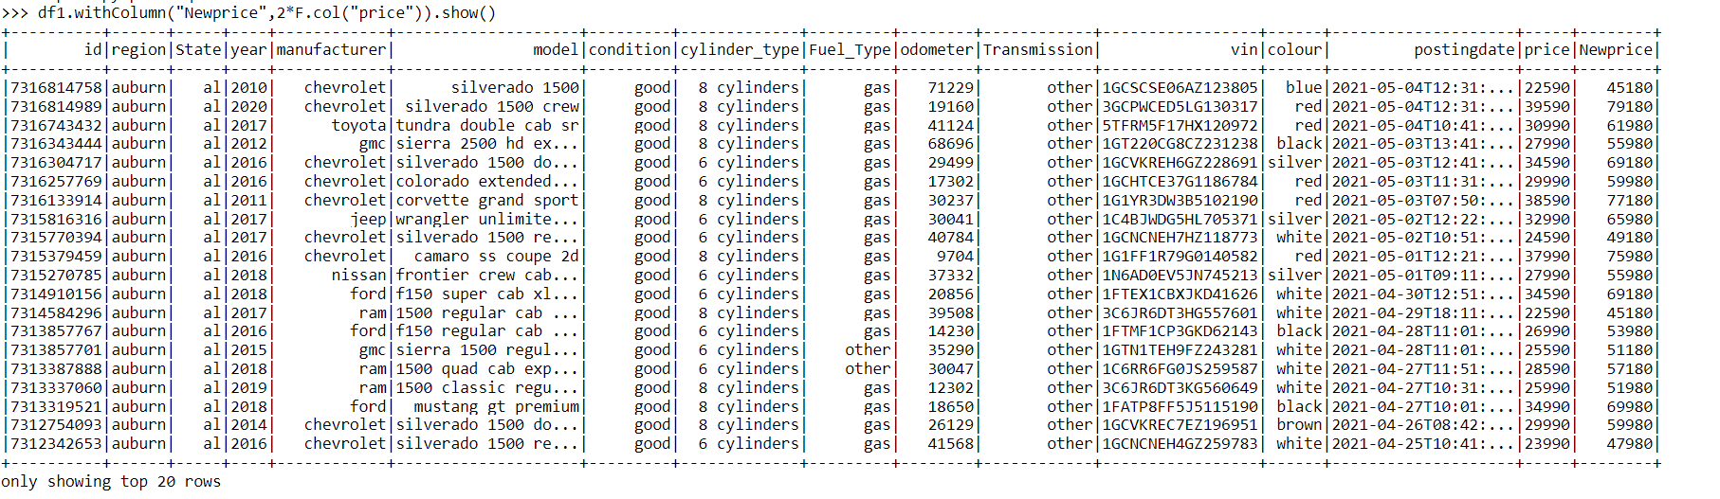
By 2021 the prices of cars increased 2 times than older prices . To add the new column for new prices. Command : df1.withColumn(“Newprice”,2*F.col(“price”)).show()

Slide 15
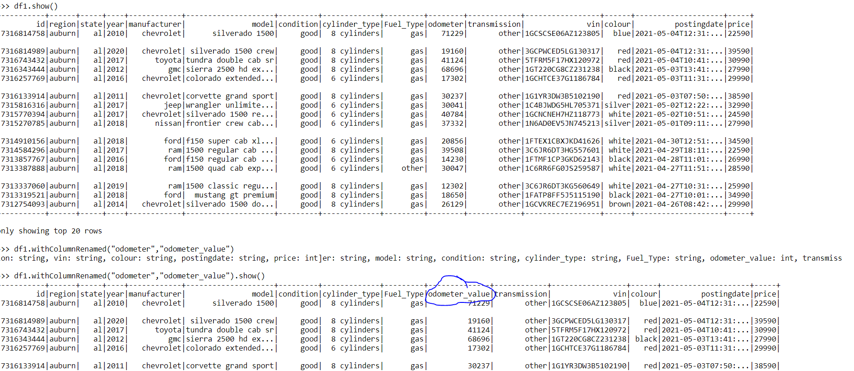
Renaming the existing column in data frame .Changed odometer column into odometer value. Command : df1.withColumnRenamed(“odometer” ,”odometer value”)

Slide 16
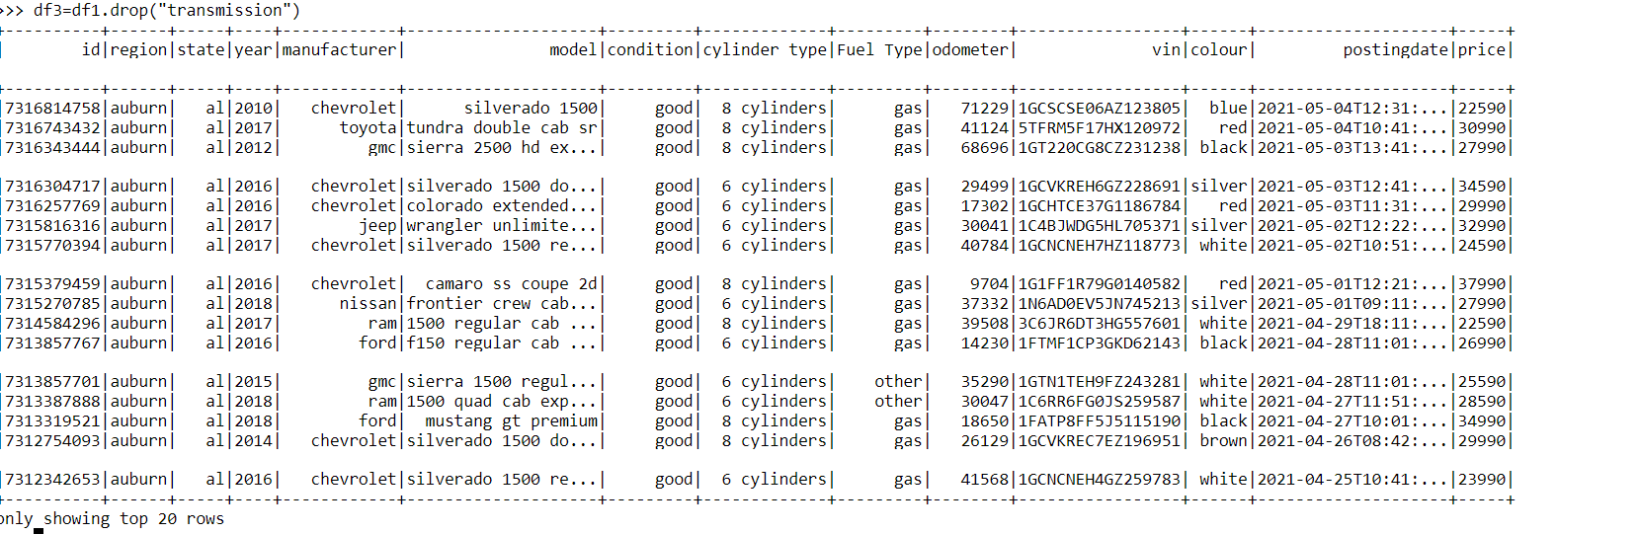
Dropping a column from the data frame. Command : df3 = df1.drop(“transmission”)

Slide 17
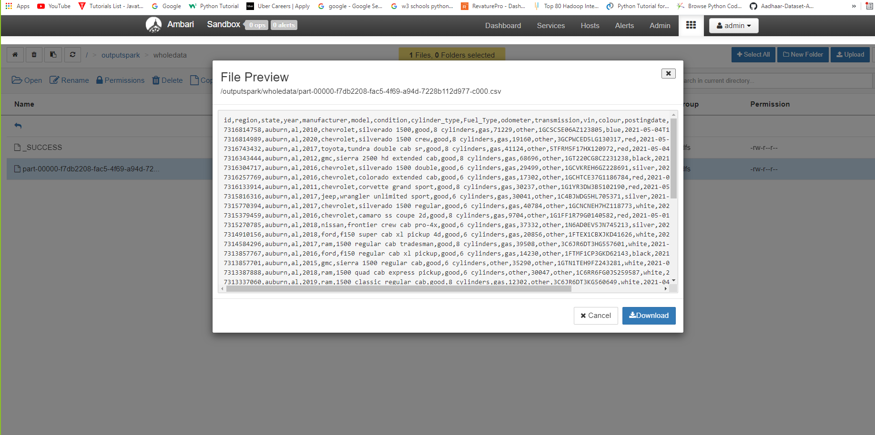
Moving data present in data frame into Ambari as a csv file. Command : df2.coalesce(1).write.options(header=‘True’,delimiter=‘,’).csv(“path”)

Slide 18
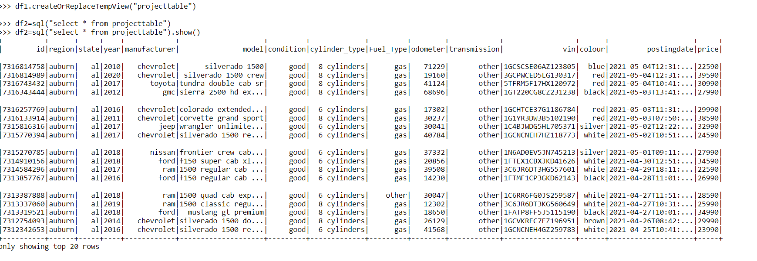
Creating a View or temporary table to perform some SQL queries on the data present in data frame. Command : df1.createOrReplaceTempView(“project table”) QUERY : df2=spark.sql(“select * from project table”)

Slide 19
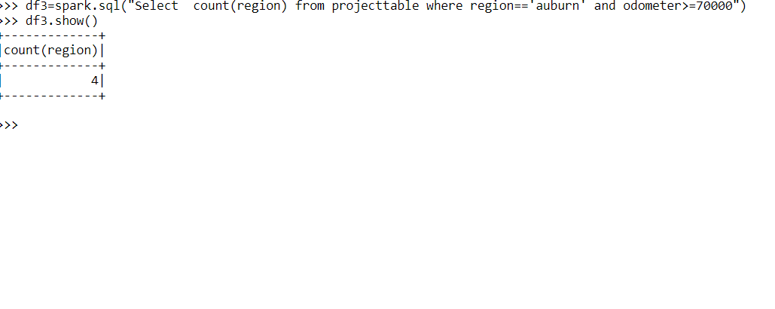
To get the count of cars from region “auburn” which covered a distance greater than 70000 using SQL query. Query : df3=spark.sql(“select count(region”) from projecttable where region=‘auburn’ and odometer > = 70000”).show()

Slide 20
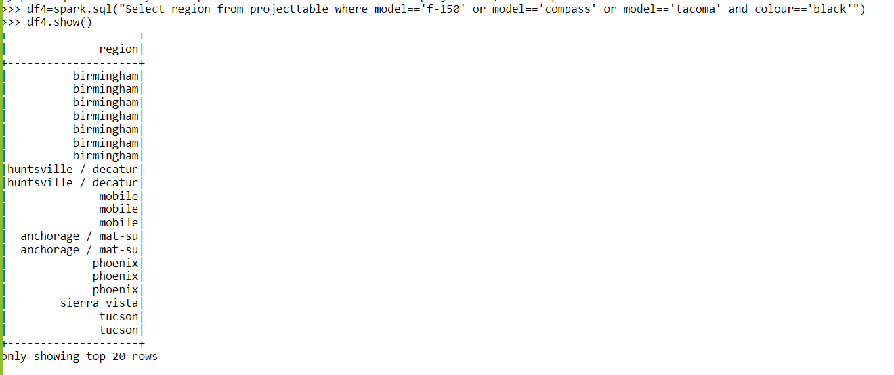
To get the region where the models ‘f-150’ or ‘compass’ , ‘Tacoma’ were available in black color using SQL query. Query : df4=spark.sql(“select region from project table where model=‘f-150’or model=‘compass’ or model = ‘tacoma’ and color = ‘black’)

Slide 21
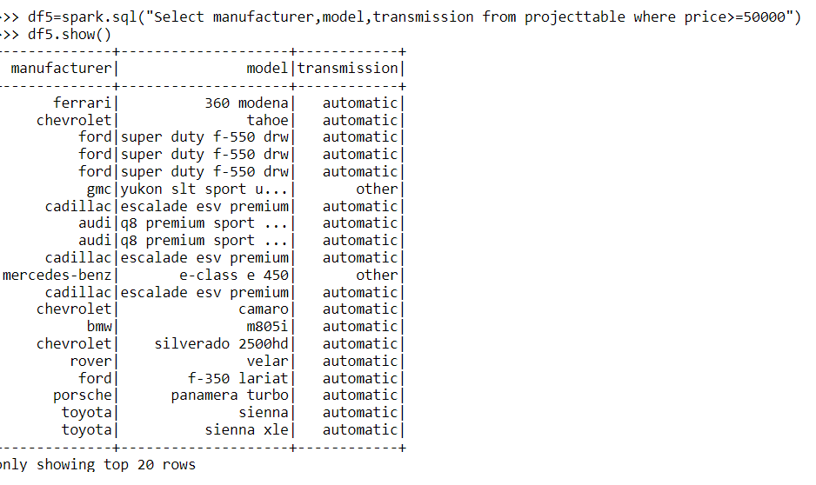
To get data of manufacturer ,model , transmission where price is greater than 50000. Query : df5=spark.sql(“select manufacturer ,model , transmission from project table where price >=50000”)

Slide 22
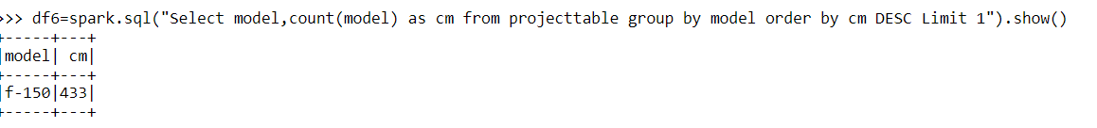
To get the model of the car which was purchased mostly. Query : df6=spark.sql(“select model , count(model) as cm from project table group by model order by cm DESC limit 1”).show()

Slide 23
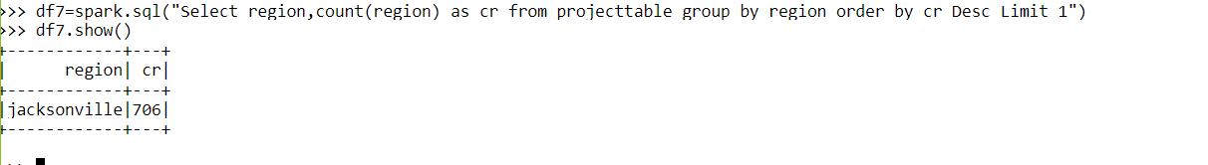
To know the region which is having the highest number of cars. Query : df7=spark.sql(“select region , count(region) as cr from project table group by region order by cr DESC Limit 1”)

Slide 24
To get the model and manufacturer mostly liked by Birmingham. Query :

Slide 25
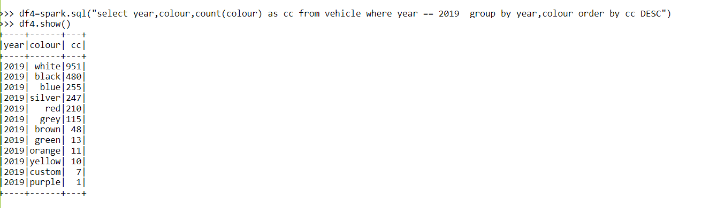
In a particular year which color cars are the most sold. Query : df4=spark.sql(“select year , color, count(color) as cc from vehicle where year==2019 group by year , color order by cc DESC”)

Slide 26
Count of cars posted in different years. Query : spark.sql(“selectsubstr(postingdate,0,4)count(substr(postingdate,0,4) from vehicle group by substr(postingdate,0,4) .show()

Slide 27
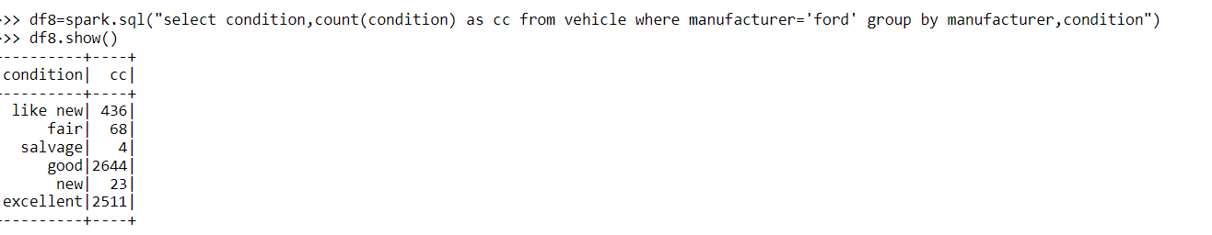
To get the count of cars according to their conditions for a particular manufacturer. Query : df8=spark.sql(“select condition , count(condition) as cc from vehicle where manufacturer=‘ford’ group by manufacturer , condition”).show()

Slide 28
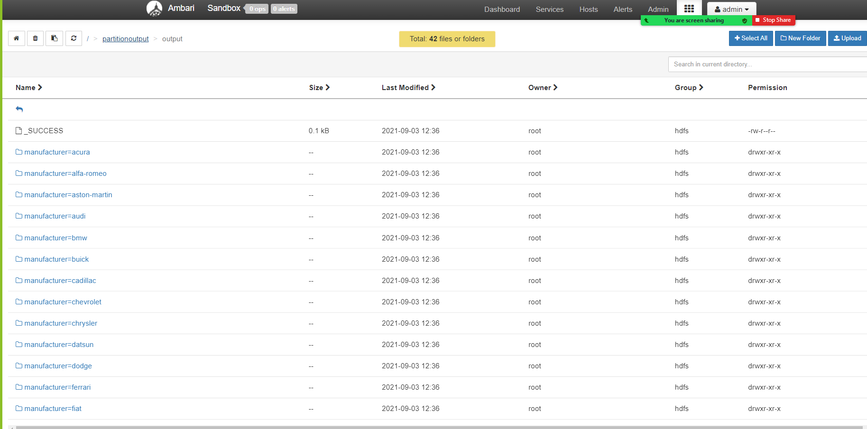
Partitioning data based on manufacturer and writing those partitioned files in the format of ‘csv’. Command : df.coalesce(1).write.partitionBy(‘manufacturer’).csv(‘path’).

Slide 29
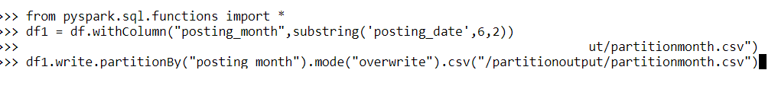
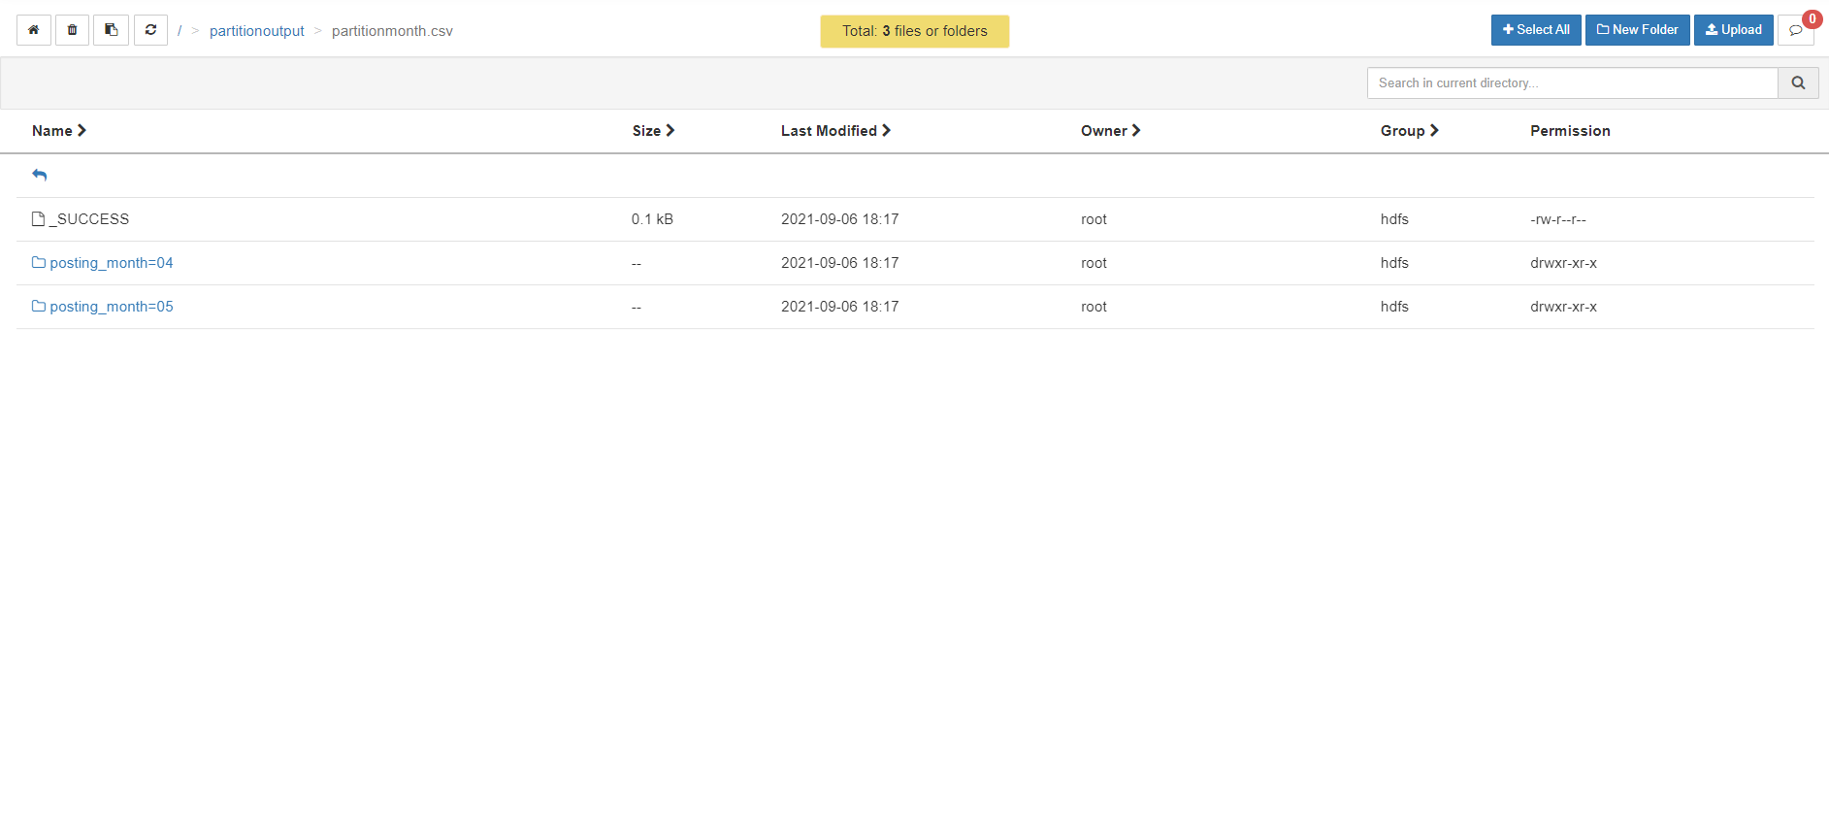
Partitioning the data based on the posting month.

Slide 30
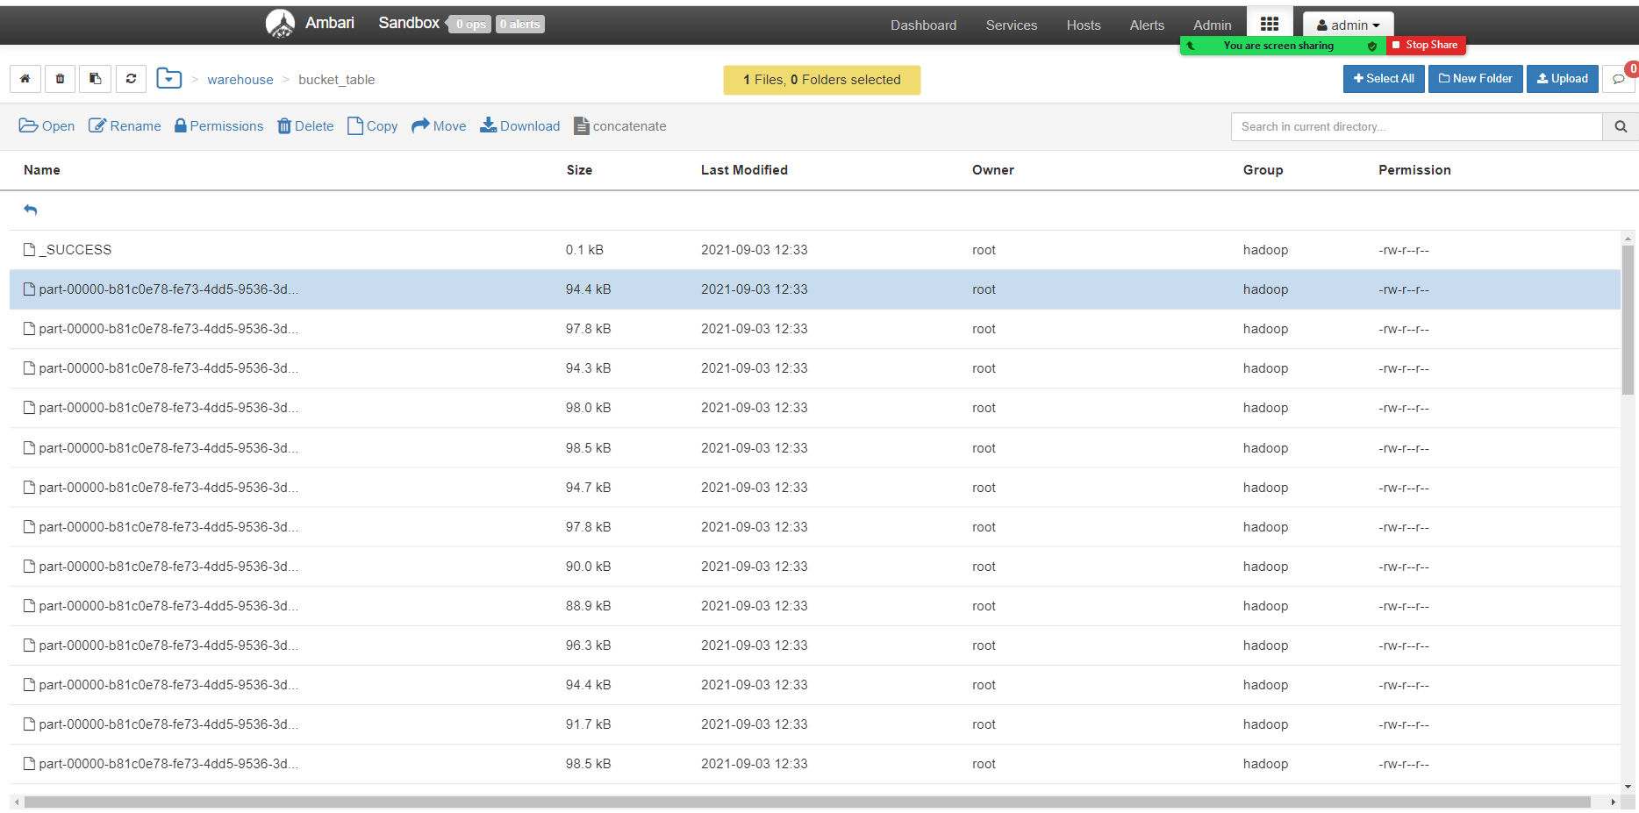
Bucketing the data into 50 buckets based on the column ‘id’. Command : df.coalesce(1).write.format(‘csv’).bucketBy(50,’id’).saveAsTable(“bucket table”)

Slide 31
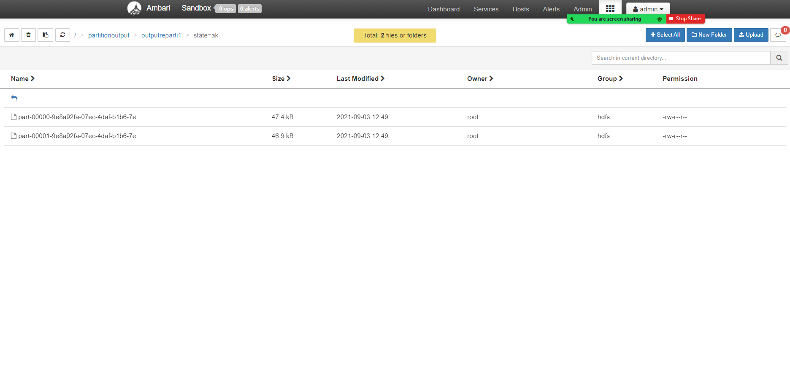
Repartitioning the partitioned file into two files using the function ‘REPARTITION’ in the data frame. Command : df.coalesce(1).repartition(2).write.option(“header”,”True”).partitionBy(‘state’).csv(“path”).

Slide 32
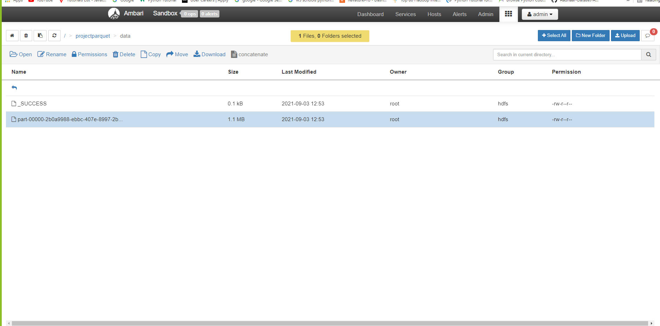
Writing the data into a parquet file. Command : df.coalesce(1).write.parquet(“/projectparquet/data”)

Slide 33
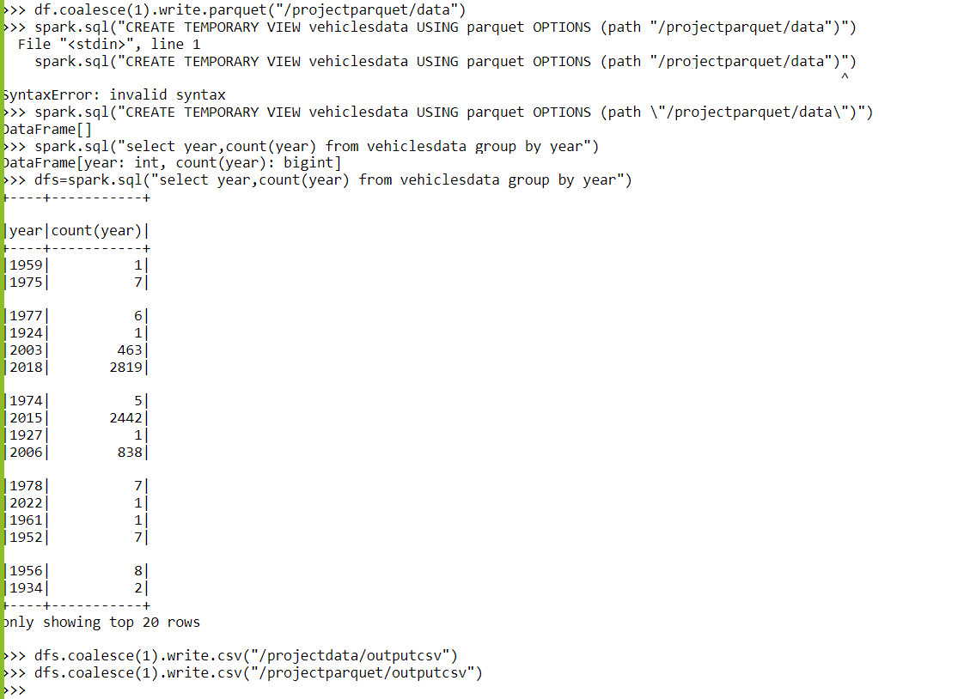
Performing some queries using SQL on the parquet file by creating a temporary table. And writing the query output into a csv file.

Slide 34
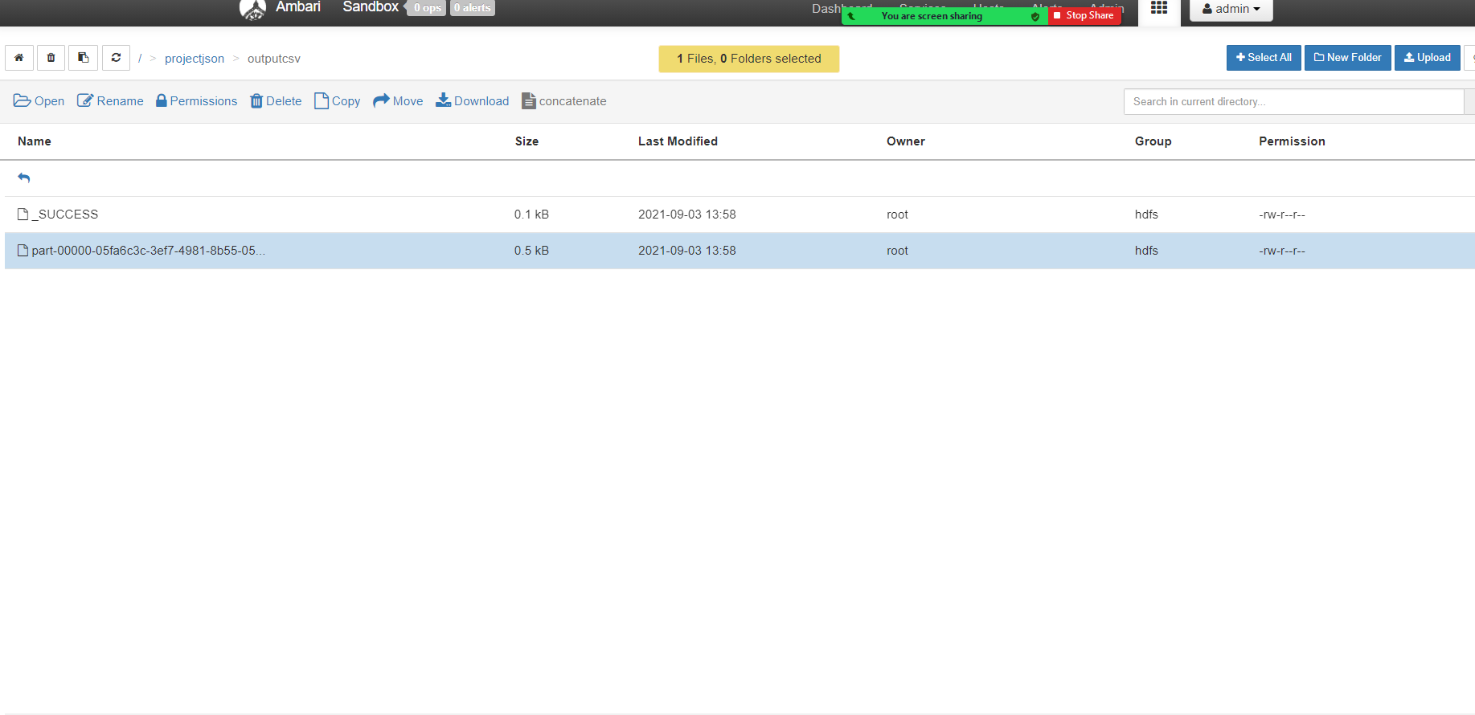
Writing the data in data frame into json file. Command : df.coalesce(1).write.json(“path”)

Slide 35
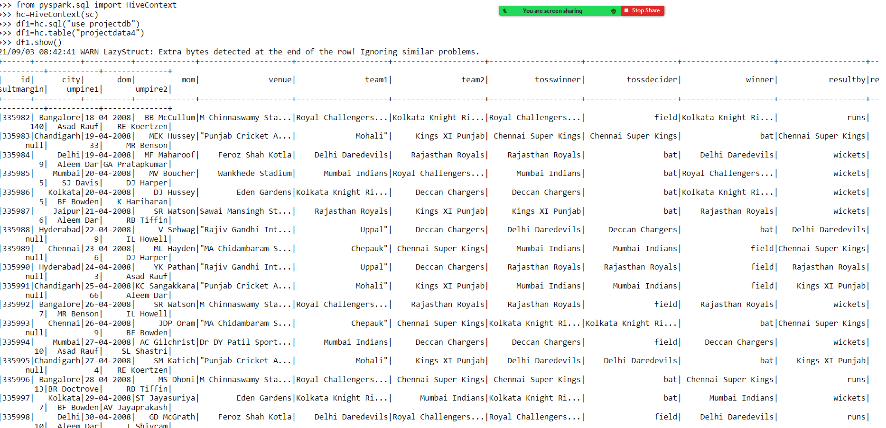
To get the data present in hive into spark data frame and perform some functions.

Slide 36
c
Conclusion :
On the basis of above analysis , we may conclude that the features of the cars are improved
more as the no. of years increases . We tried our best to include all the necessary points that are required related to the given dataset . we also included analysis on our own dataset created
using hashtag.
It was a wonderful and learning experience for us while working on this project . This project
took us through the various phases of projects development and gave us the real insight
into the world of data analysis . The joy of work and the thrill involved while tackling the
various problems and challenges gave us a feel of developers industry.

